Slide 1
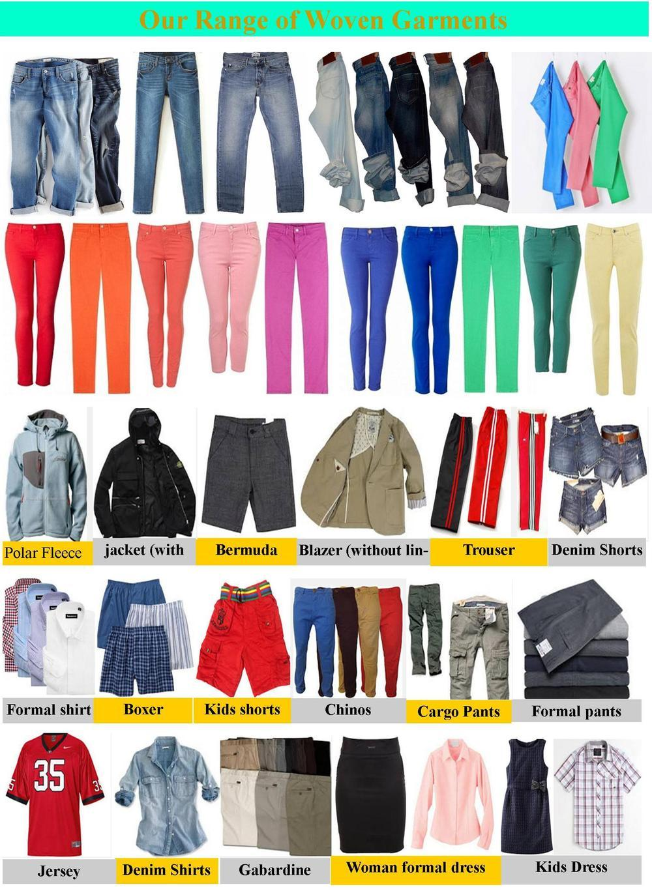
Garment Styles and Parts

Slide 2
Dress Styles
Dresses have been the main item of female apparel in the Western Hemisphere for centuries.
Dresses were called a robe or a gown.

Slide 3
Classic Dress Styles
The three classic dress styles:
Sheath: a close-fitting dress that is shaped by darts
Shift: a loose fitting dress
Princess: a close-fitting, flared dress that is shaped by seams (pieces of fabric sewn together)

Slide 4
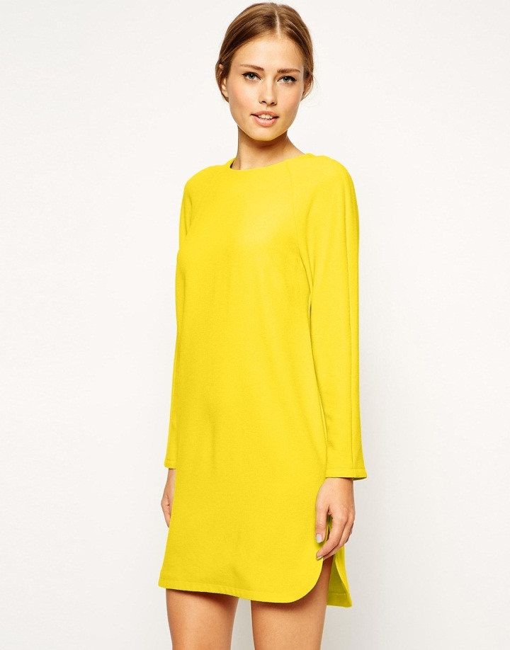
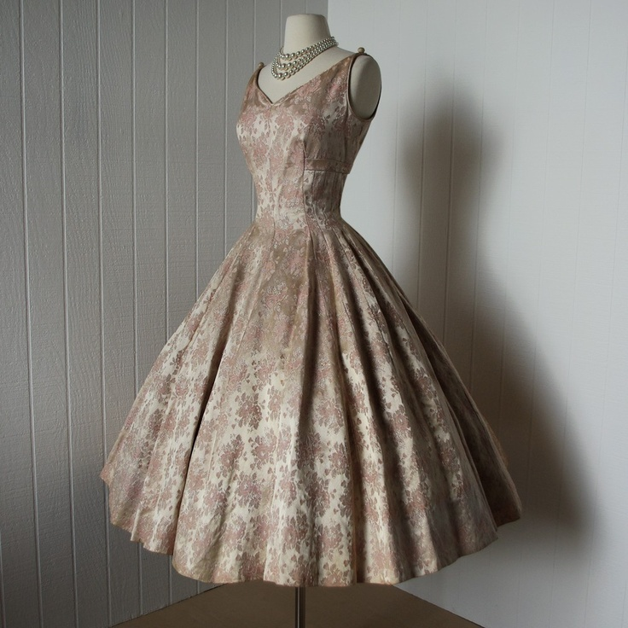
Sheath
Shift
Princess

Slide 5
Neckline Styles
A neckline refers to the area around the neck and shoulders. Before the 20th century, garments from the same period all had similar necklines.
Today fashion features many different types of necklines in a season.

Slide 6
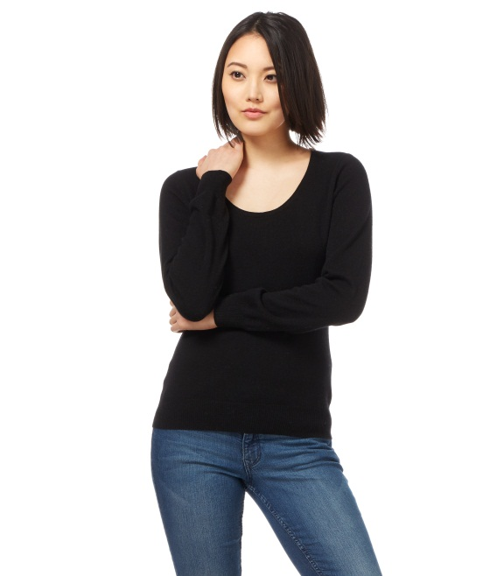
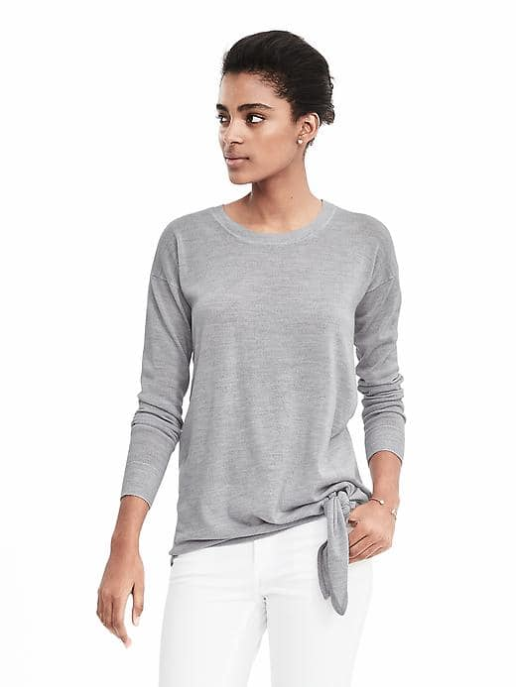
Classic Neckline Styles
Jewel: round neckline that makes a good background for jewelry and necklaces.
Crew: a high, round neckline finished with a knit band.

Slide 7
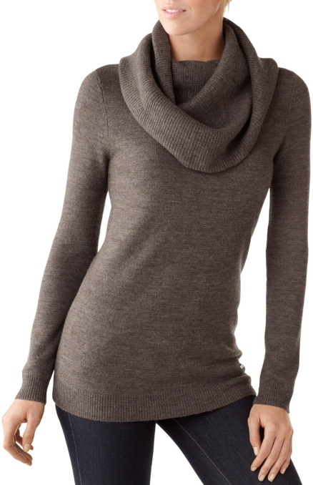
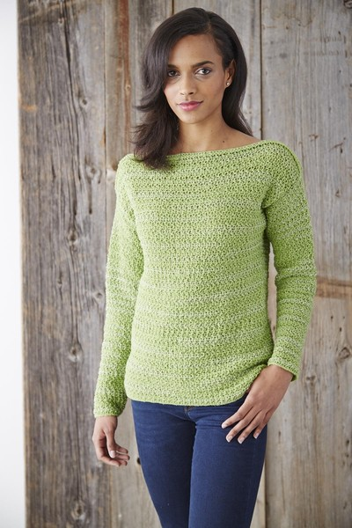
Classic Neckline Styles
Cowl: Usually part of shirt of dress that is cut on the bias to make the neckline drape better. Cowl means softly draped. Originally it was a hooded garment worn by monks.
Bateau: French word for boat. A bateau neckline is a straight opening across the neck of a garment.

Slide 8
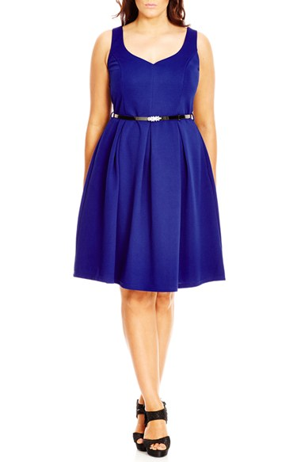
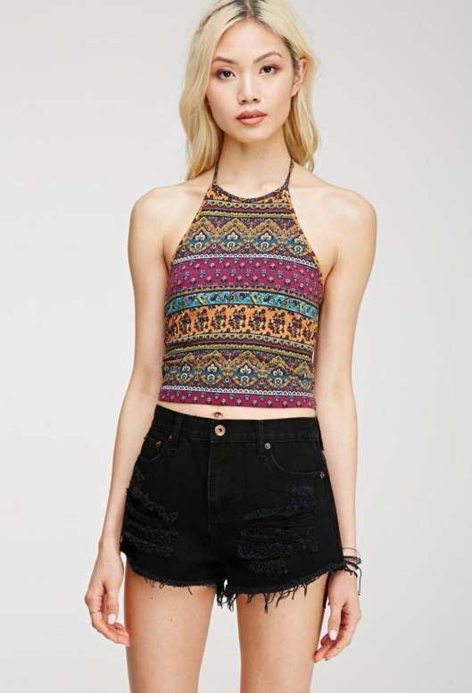
Classic Neckline Styles
Sweetheart: is moderately low and heart-shaped in the front
Halter: consists of a sleeveless front held in place at the neckline with a drawstring or band. The shoulders and back are bare.

Slide 9
Collar Styles
A collar is a separate piece of fabric that is attached to the neckline of a garment.
It can be small or large, stand-up or fold-over, soft or stiff. Most collars are permanently attached.

Slide 12
Sleeve Styles
Primitive clothing had sleeves that were cut with the garment in one piece.
In the Middle Ages, the set-in sleeve became popular. Today we wear many different types of sleeves.

Slide 13
Sleeve Styles
Set in sleeve is joined to the garment by an armhole seam that circles the arm near the shoulder.
Raglan sleeve has a front and back diagonal seam that extends from the neckline to the armhole.
Kimono sleeve is cut in one piece with the front and the back of the garment.

Slide 15
Shirt Styles
The term shirt was historically used to describe a piece of clothing that was more tailored than a blouse. It had a collar, sleeves with cuffs, and front opening with buttons.
A blouse may or may not include a collar, sleeves, pleats, strings, or buttons.

Slide 16
Skirt Styles
Today a skirt is described as a separate piece of clothing that can be worn with any style of top.
However, from medieval times until the 18th century, dresses were usually made with separate skirts and bodices. In the 1870’s, women began to wear tailored suits with separate skirts and jackets.
Skirts can be straight, flared or full. Darts, gathers, pleats, or seams shape them.

Slide 17
Skirt Styles

Slide 18
Pants
In ancient times, Persian and Anglo-Saxon men wore pants.
However, the pant was not used until the late 1800s. At that time, it meant outer garments worn by men and boys. Today both men and women wear pants.
Pant styles vary in width as well as length.
Flared (bellbottoms)
Straight
Tapered
Bermuda
Culottes
Leggings

Slide 19
Pants

Slide 20
Jacket and Coat Styles
The word coat comes from the English word cloak, which was a large piece of fabric. It was wrapped around the body over outer clothing to keep the wearer warm.
The term jacket comes from the French word jaquette, which means little coat.
Today jacket usually means an outer layer of clothing that is hip-length or slightly longer or shorter.
A jacket can be worn as an outer layer or under a coat.
Jackets and coats can be single breasted or double breasted.

Slide 21
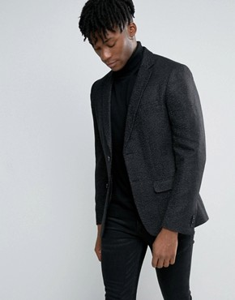
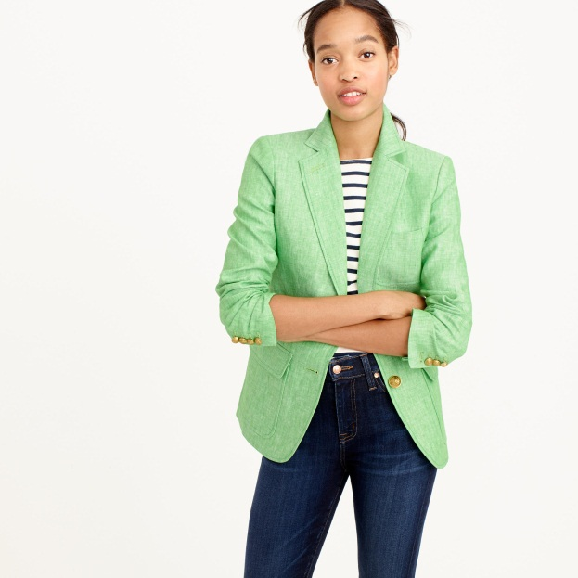
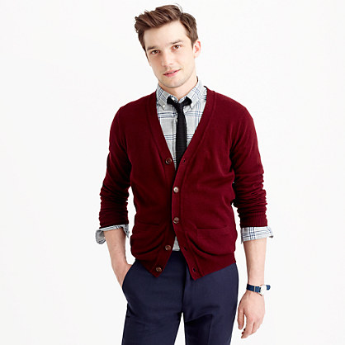
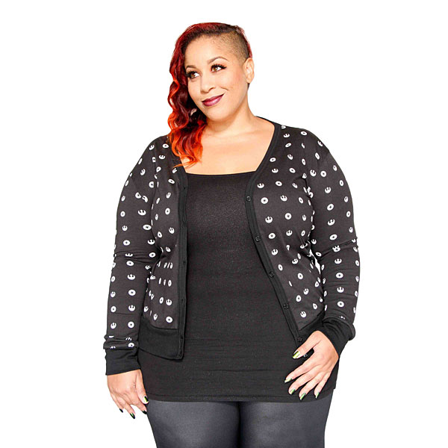
Classic Jacket Styles
Blazer: solid-colored jacket that can be single or double breasted.
Cardigan: a collarless jacket or sweater that buttons down the front.

Slide 22
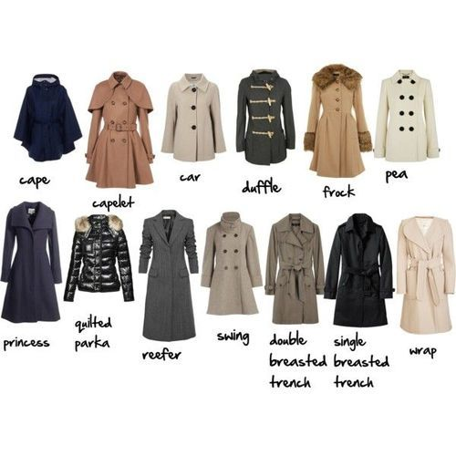
Classic Women’s Jackets

Slide 23
Classic Men’s Jackets

