Slide 1
TEXTILES
Greater Seattle ASG Spring Inspiration
Marisol Olsen, president

Slide 2
Textiles
Complicated, technical, deep subject that is constantly evolving
Most textiles are manufactured today
Manufacturing process
begins with fibers
which are made into yarns
which are then woven or knit into fabric
final step may be “finished” or “printed”
Notes:
Flax textiles found dating back to 34,000 BCE indicates textile production occurred during pre-historic times
Today - Modern industrialization has radically altered this field – both the method of production as well as the materials used
Engineers, chemists, electronic experts, and many other disciplines are involved in developing next generation of textiles or finishes

Slide 3
Textiles: Fibers are Fundamental
Fibers are smallest visible component of most fabrics
Fibers can be found in nature or manufactured
Natural fibers can be cellulosic (plants) or protein (animals)
Synthetic fibers are derived from distillates of petroleum or coal
Manufactured fibers can be derived from natural or synthetic sources
Notes:
Cellulosic fibers are from plants – cotton, flax (linen), hemp, etc
Protein fibers are from animals – wool, mohair, cashmere, camel, silk
MF fiber examples originating from natural elements include rayon, acetate, Tencel
Some synthetic manufactured fibers polyester, acrylic, vinyl – polyester being the major one

Slide 4
Textiles: Fiber Properties
Utilitarian Properties
Comfort
Absorbency
Wicking
Heat management
Stretch
Hypo-allergenic
Weight
Notes:
These properties are how we “grade” fibers/fabrics – evaluate their appropriateness for specific applications/jobs
Other sensitivities include mildew, acid, insect larvae, perspiration, and others
Good resource for understanding the properties of different fibers is Claire Schaeffer’s book – Fabric Sewing Guide – read an excerpt from about cotton – page 35

Slide 5
Textiles: Fiber Properties
Utilitarian Properties
Safety
Abrasion Resistance
Flammability
Chemical
Notes:
These properties are how we “grade” fibers/fabrics – evaluate their appropriateness for specific applications/jobs
Other sensitivities include mildew, acid, insect larvae, perspiration, and others
Good resource for understanding the properties of different fibers is Claire Schaeffer’s book – Fabric Sewing Guide – read an excerpt from about cotton – page 35

Slide 6
Textiles: Fiber Properties
Utilitarian Properties
Appearance Retention/Durability
Static resistance
Shrinkage
Resistance to insects, mildew, fungus, sunlight
Crushing/Wrinkling/Pilling
Notes:
These properties are how we “grade” fibers/fabrics – evaluate their appropriateness for specific applications/jobs
Other sensitivities include mildew, acid, insect larvae, perspiration, and others
Good resource for understanding the properties of different fibers is Claire Schaeffer’s book – Fabric Sewing Guide – read an excerpt from about cotton – page 35

Slide 7
Textiles: Fiber Properties
Aesthetic Properties
Color
Hand
Tactile Texture
Visual Texture (pattern)
Drape
Luster
Notes:
These properties are how we “grade” fibers/fabrics – evaluate their appropriateness for specific applications/jobs
Other sensitivities include mildew, acid, insect larvae, perspiration, and others
Good resource for understanding the properties of different fibers is Claire Schaeffer’s book – Fabric Sewing Guide – read an excerpt from about cotton – page 35

Slide 8
Textiles: Fiber Identification Tests
Burning
Cellulosic fibers burn intensely, smell like burning wood/paper/leaves,,, have soft gray ash
Polyester fibers burn/melt, may smell aromatic, have hard bead “ash”
Silk burns slowly, smells like burning feathers, “crushable” ash
Notes:
Basically – tough to test conclusively at home
Two tests that can be done at home:
Burning – simplest test – but only works if there is a single fiber type present in the yarn and no finish
Microscopic – obviously need a microscope – even a child’s one can work
Tests need to be done in lab:
Staining – good cross-check if the fibers are not already too dark either naturally or from dyes
Chemical tests are good if 2 or more fibers are present – acetone nail polish remover can be used at home – all others are done in lab
Last 2 are specialized fiber DNA tests

Slide 9
Textiles: Fiber Identification Tests
Microscopic examination
Staining
Solubility or chemical (acetone dissolves acetates)
Fiber density, infrared spectrophotometry, gas chromatography
Fiber melting point
Notes:
Basically – tough to test conclusively at home
Two tests that can be done at home:
Burning – simplest test – but only works if there is a single fiber type present in the yarn and no finish
Microscopic – obviously need a microscope – even a child’s one can work
Tests need to be done in lab:
Staining – good cross-check if the fibers are not already too dark either naturally or from dyes
Chemical tests are good if 2 or more fibers are present – acetone nail polish remover can be used at home – all others are done in lab
Last 2 are specialized fiber DNA tests

Slide 10
Textiles: Major Advantages/Disadvantages of Fibers
Notes:
Everything has some advantage/some disadvantages – so you weight the factors when making a decision about which fiber to use
Textile family tree – shows major groupings/

Slide 11
Textiles: Yarns
Yarn is a continuous strand of textile fibers, filaments, or other material spun into a form that can be used for knitting, weaving, or other interwining to form a textile fabric
Filament yarn
Spun yarn
https://www.youtube.com/watch?v=YHHqFwDhGTM
Notes:
Filament yarn:
also called continuous filament yarn
Can be a single continuous filament – most manufactured fibers are multifilament
Main uses of monofilament yarn are hosiery, wiry millinery or hem braids
Produced by gathering filaments together to create a multifilament yarn
Multifilament yarn can be twisted or not
Spun Yarn
Mechanical spinning of staple fibers
Twisted and drawn out to form yarn
Probably many of you have seen a spinning wheel at country fairs, or maybe some of you are spinners

Slide 12
Textiles: Yarn
How it’s made/classified/measured/etc
https://www.youtube.com/watch?v=YvytxufYfZg
Notes:
Go thru about 4 minutes

Slide 13
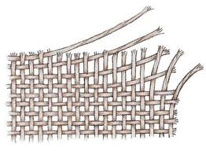
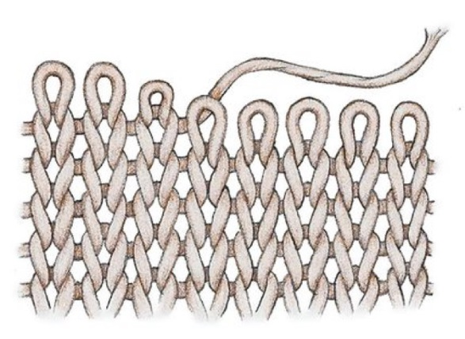
Textiles: Fabrics
Right side vs. Wrong side
Weaving
Basic Weaves
Complex Weaves
Knitting
Other Construction Methods

Slide 14
Textiles: Basic Fabric Weaves
A woven fabric is made of two sets of yarns interlaced at right angles to each other on a loom with 2-8 harnesses. The yarns running in the direction of the selvedge are the warp and the yarns running between the selvedge are the weft (or filling).
Plain weave: each warp and weft yarn interlaces with the next yarn. Variations include different yarn weight or thread count in warp and weft, or different colors of yarn to create plaids or stripes
Twill weave: warp or weft yarns skip over multiple yarns in the opposite direction causing floats. The floats are arranged in visible diagonal line.
Satin weave: also woven with floats, but they are not arranged in distinct lines, so the surface is very smooth.
Notes:
Woven: weaving is the process of interlacing yarns at right angles to each other on a loom or “weaving machine”. Warp threads are parallel to selvedge; weft (or filling threads) are perpendicular
Basic weaves
Plain weave is simplest and most commonly used – examples are chambray, broadcloth, percale, muslin, calico, challis
Twill weaves are seldom printed; fray very easily – denim, canvas, drill, duck, wool
Satin weaves are commonly special occasion fabrics

Slide 15
Textiles: Complex Fabric Weaves
Jacquard: The word “jacquard” is used loosely for any textile made with more than 25 warp arrangements. The looms do not use harnesses. They use wire to lift each warp yarn.
Damask – reversible fabric with complex design
Jacquard – reversible fabric with tapestry or floral design
Brocade – embossed or raised floral or scroll design with floats on backside
Extra Yarn Weaves introduce extra yarns in the warp or weft to create textures or patterns
Pile fabrics such as velvet and terry cloth
Dobby dots and stripes
Spot weaves in the shapes of flowers or animals or geometric shapes like dotted swiss
Leno: twists the warp yarn between the weft making a space like a lattice
cheesecloth
Notes:
Dobby – small (usually) geometric design close together
Jacquard – incredibly complex designs because each weft yarn can be controlled separately for each pick (insertion of the weft)
Leno – also called lock, doup, or gauze weave and used to produce cheesecloth and bandages (gauze fabric is a plain weave)
Surface Figure weaves are created by adding extra yarns – common example of this construction method is dotted Swiss
Pile Weaves – creates a 3-dimensional effect by weaving an extra set of warp or weft yarns into the basic structure of the fabric – can be left uncut as loops (terry cloth)
or cut to give a plush effect (velvet)

Slide 16
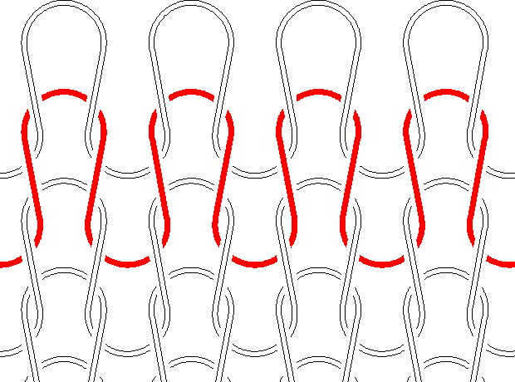
Textiles : Knit Fabric Construction
Weft knits: A weft knit fabric is made from a single yarn looped onto itself by a row of multiple needles resulting in courses of loops. They and can be knitted on a flat or circular machine.
Single weft knits are made on a single set of needles
jersey is the most common
dropped stitch and tuck stitch open spaces between wales creating pointelle or mesh
Double knits are made on two sets of needles
interlocks & ponte
Rib knits are made with a single yarn on two sets of needles
Warp knits: a warp knit is made of multiple yarns that are interlooped vertically and diagonally
Tricot, Milanese, Raschel lace, Missoni zigzag knit
Notes:
Knits: originally hand-knitting, then knitting machines using needles to manipulate yarns into connected loops. Only 4 basic stitches: plain, rib, purl & warp
Weft stitch variations include float or miss stitch, tuck, half-cardigan, full cardigan, and rack stitch
Milanese is more expensive/better quality tricot – hard to find

Slide 17
Textiles: Other Construction Methods
With Yarns
Twisting/Knotting
Tufting
Without Yarns
Felt
Nonwovens (interfacings)
Leather/Fur

Slide 18
Textiles: Videos
Wool
https://www.youtube.com/watch?v=uEYsmzophTA&t=5s
Polar Fleece
https://www.youtube.com/watch?v=YHHqFwDhGTM&t=189s

Slide 19
Textiles: Fabric Finishing
Heat setting (polyester and nylon)
Napping
Calendaring (mill ironing)
Creping
Crinkle sheeting
Stiff or Crisp finish
Softeners
Mill washing (stone washing, distressing, etc)
Added Value /Special Purpose Finishes
Notes:
Added Value/Special Purpose Finishes
Impermeable, water replant, temperature regulation, stain repellant, moisture mgmt

Slide 20
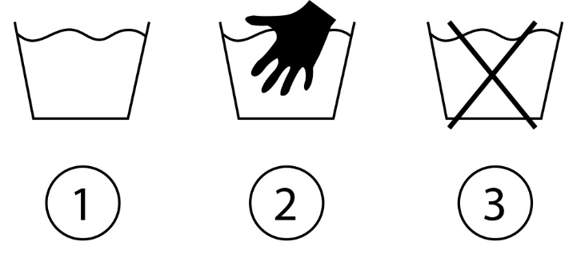
Textiles: Care of Fabrics
Home care
Home laundering
1 machine wash
2 hand wash
3 never wash

Slide 21
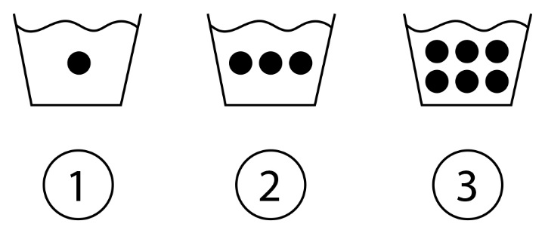
Textiles: Care of Fabrics
Home care
Home laundering
1 wash cold
2 wash warm
3 wash hot

Slide 22
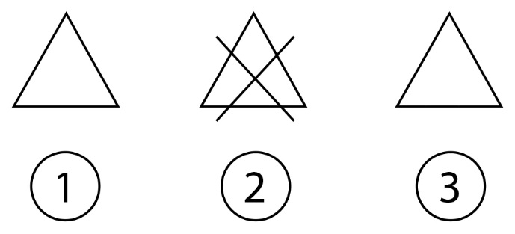
Textiles: Care of Fabrics
Home care
Home laundering
1 bleach permitted
2 no bleach
3 color-safe bleach only

Slide 23
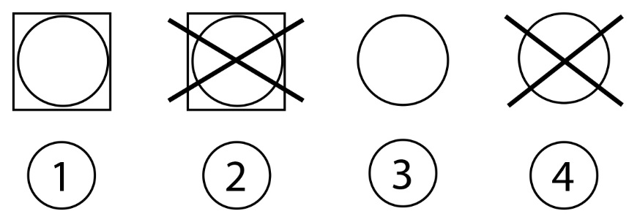
Textiles: Care of Fabrics
Home care
Home laundering
1 tumble dry
2 never tumble dry
3 dry clean only
4 never dry clean

Slide 24
Textiles: Care of Fabrics
Home care
Home laundering
1 iron cool
2 iron medium
3 iron hot
4 never iron
Source: Tide.com

Slide 25
Textiles: Care of Fabrics
Home care
Stain removal: see attached chart
Commercial Cleaning
Traditional dry cleaners
Environmentally friendly process – toxin free (Blue Sky)

Slide 26
Textiles: Reference Materials
Resources:
Fabric Reference by Mary Humphries
Fabric Glossary by Mary Humphries
Fabric Sewing Guide by Claire Schaeffer
Notes:
Resources:

